Slide 1
Managing Human Capital in Retail
Effective Staffing: The Right Number of People
Matthew Bidwell, Associate Professor of Management

Slide 2
Effective Staffing Overview
What it means to hire effectively
Best practices in selecting employees
Building the talent pipeline

Slide 3
How Many People Should You Hire
Marginal Cost
=
Marginal Revenue
Pay and benefits
Better customer interactions
Improved customer service
Ability to maintain logistical processes
Better maintained spaces
Time available for innovation

Slide 4
Managing Human Capital in Retail
Effective Staffing: The Right People
Matthew Bidwell, Associate Professor of Management

Slide 5
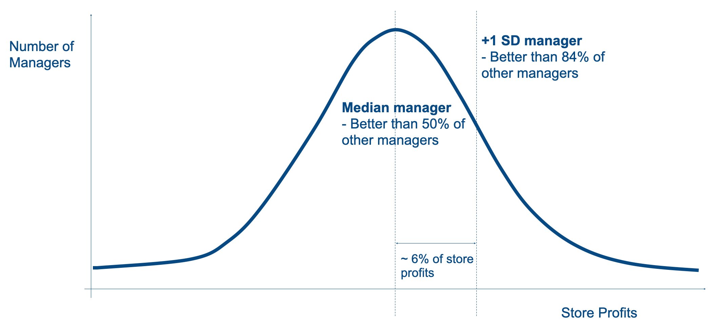
How Much is a Good Manager Worth?

Slide 6
Managing Human Capital in Retail
Effective Staffing: The Problem with Intuition
Matthew Bidwell, Associate Professor of Management

Slide 7
Some Problems with Intuition
Hiring the right people is not something we do well naturally

Slide 8
“
We were quite willing to declare: “This one will never make it,” “That fellow is rather mediocre, but should do O.K.,” or “He will be a star.” We felt no need to question our forecasts, moderate them, or equivocate.”
— Daniel kahneman

Slide 9
The Problem with Intuition
Hiring the right people is not something we do well naturally
“What you see is all there is”
Tendency to draw very strong conclusions on the basis of very week data
Kahneman 2011

Slide 10
Managing Human Capital in Retail
Best Practices in Selecting Employees: Identify Your Criteria
Matthew Bidwell, Associate Professor of Management

Slide 11
Effective Staffing Overview
Identify your criteria — what are you looking for?
Evaluate candidates — who has what we are looking for?
Integrate scores across different criteria

Slide 12
Managing Human Capital in Retail
Best Practices in Selecting Employees: Evaluating Candidates
Matthew Bidwell, Associate Professor of Management

Slide 13
What Works in Evaluating Candidates?
Less effective
More effective
Graphology
Reference checks
Unstructured interviews
Cognitive ability tests
Work samples
Structured interviews

Slide 14
What is a Structured Interview?
Questions clearly tied to key skills and abilities needed for job
Ask every candidate the same questions
Define scoring beforehand in order to systematically evaluate answers
Respondents scored on each attribute
Interviewers trained on the questions

Slide 15
What is a Structured Interview?
Question Types
Past experience
“Tell me about a time when you had to work with others to achieve a goal. What approach did you take and what were the results?”
Situational judgment
“Imagine you are working with a teammate who is not meeting her commitments. How would you address this?”

Slide 16
Managing Human Capital in Retail
Best Practices in Selecting Employees: Integrating Scores
Matthew Bidwell, Associate Professor of Management

Slide 17
Effective Staffing Overview
Identify your criteria — what are you looking for?
Evaluate candidates — who has what we are looking for?
Integrate scores across different criteria

Slide 18
Effective Staffing Overview
Validity (correlation of predictions w outcomes)
Predicting neurosis vs. psychosis
Illinois students’ predictions of GPA
Oregon students’ predictions of GPA
Prediction of faculty ratings

Slide 19
Effective Staffing Overview
Validity (correlation of predictions w outcomes) | Judge predictions
Predicting neurosis vs. psychosis | .28
Illinois students’ predictions of GPA | .33
Oregon students’ predictions of GPA | .37
Prediction of faculty ratings | .19

Slide 20
Effective Staffing Overview
Validity (correlation of predictions w outcomes) | Judge predictions | Sum of criteria (equal weights)
Predicting neurosis vs. psychosis | .28 | .34
Illinois students’ predictions of GPA | .33 | .6
Oregon students’ predictions of GPA | .37 | .6
Prediction of faculty ratings | .19 | .48

Slide 21
Effective Staffing Overview
Validity (correlation of predictions w outcomes) | Judge predictions | Sum of criteria (equal weights) | Sum of criteria (random weights)
Predicting neurosis vs. psychosis | .28 | .34 | .30
Illinois students’ predictions of GPA | .33 | .6 | .51
Oregon students’ predictions of GPA | .37 | .6 | .51
Prediction of faculty ratings | .19 | .48 | .39

Slide 22
Effective Staffing Overview
Validity (correlation of predictions w outcomes) | Judge predictions | Sum of criteria (equal weights) | Sum of criteria (random weights) | Sum of criteria (weights inferred from Judge predictions)
Predicting neurosis vs. psychosis | .28 | .34 | .30 | .31
Illinois students’ predictions of GPA | .33 | .6 | .51 | .5
Oregon students’ predictions of GPA | .37 | .6 | .51 | .43
Prediction of faculty ratings | .19 | .48 | .39 | .25

Slide 23
Managing Human Capital in Retail
New Technologies in Hiring
Matthew Bidwell, Associate Professor of Management

Slide 24
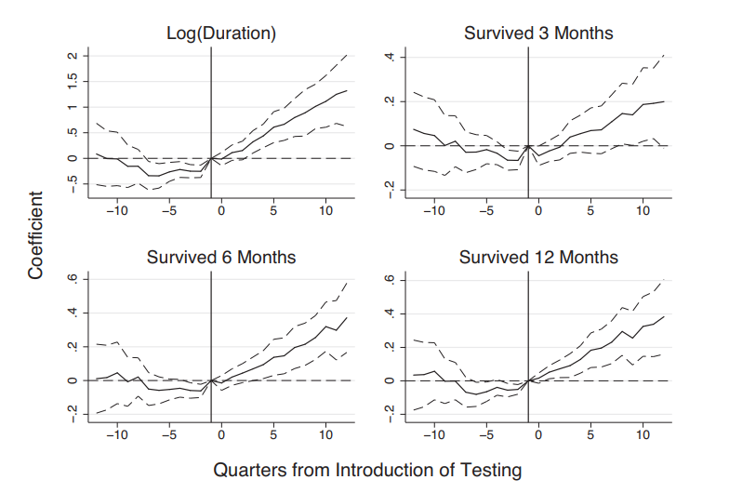
The Value of New Screening Tools
Candidates to clerical job take online test covering scenarios, technical skills, cognitive skills, and job fit
Results calibrated with current employees to predict performance and retention
Hiring managers given red/yellow/green recommendations
Go through normal hiring process subsequently
Hoffmann, Li & Kahn 2018

Slide 25
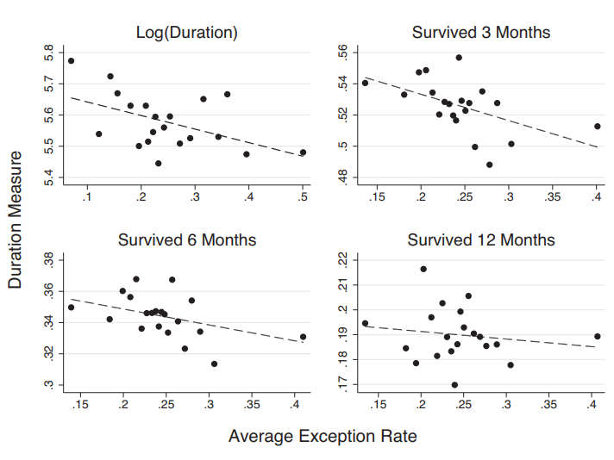
Does it pay to listen to the machine?
Managers have discretion to ignore “red flag” recommendations
Effect of manager exceptions on retention rate studied
Hoffmann, Li & Kahn 2018

Slide 26
Managing Human Capital in Retail
Developing the Talent Pipeline
Matthew Bidwell, Associate Professor of Management

Slide 27
Why Promote from Within?
3 Benefits
Motivation
The prospect of being promoted is an important source of motivation
Potentially, the people who you promote are going to be more committed than a new, outside hire
Knowledge
A person you promote will already know the organization, its products, and its customers
Cost

Slide 28


